Slide 1
Artificial Intelligence in Education
AI is changing the way we learn, teach, and create.
AI
Learn
Teach
A simple overview of benefits, uses and challenges
Create
Learn more about AI

Slide 2
What is AI and how is it used?
• AI enables computers to perform tasks that normally require human intelligence.
• It can personalize learning based on a student's progress.
• Teachers can use AI tools for feedback, planning and content creation.
• Students can use AI for practice, research and accessibility support.
🤖
AI +
Education
SMART LEARNING

Slide 3
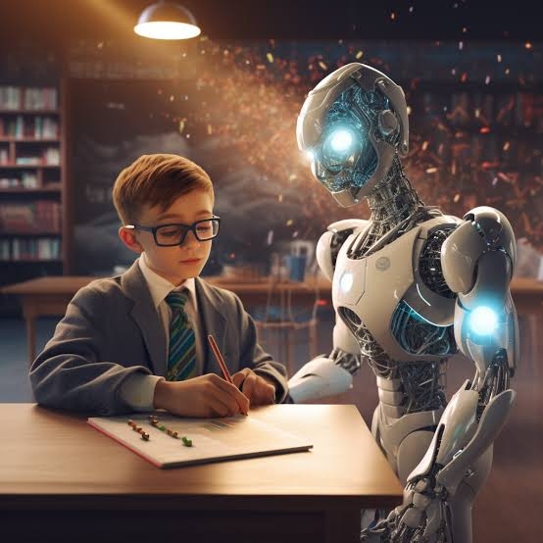
AI Helps Students and Teachers
Personalized Learning
AI can provide learning content according to each student's needs.
Quick Feedback
Students can receive immediate feedback on their work.
Easy Research
AI tools can help students understand topics and find information.
Support for Teachers
Teachers can use AI for lesson planning, creating quizzes, and preparing study material.

Slide 4
Benefits and challenges
Area | Benefits | Challenges
Learning | Personalized practice | Over-dependence on AI
Teaching | Faster feedback and planning | Accuracy must be checked
Access | Support for different learning needs | Privacy and digital access
Key idea: AI should support learning—not replace human thinking.

Slide 5
Conclusion
The Future of Learning is Human + AI
• AI can make learning more personalized and accessible.
• Teachers remain important for guidance, creativity and human connection.
• Responsible use, fact-checking and privacy awareness are essential.
THANK YOU

